Slide 1
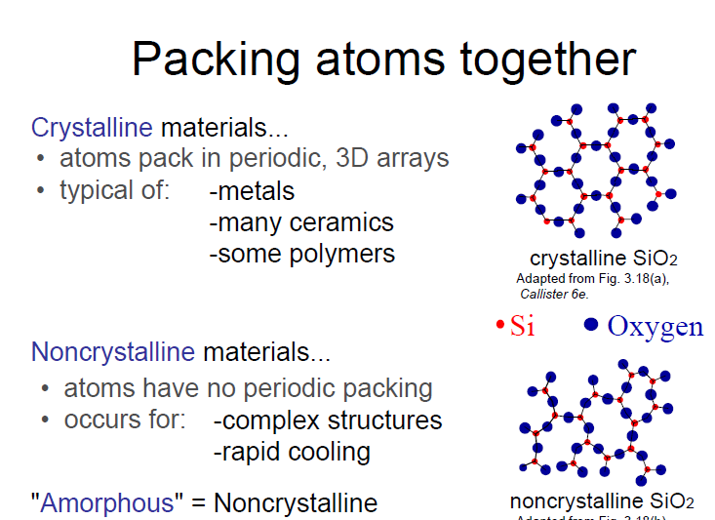
Structure of Crystalline Solids

Slide 2
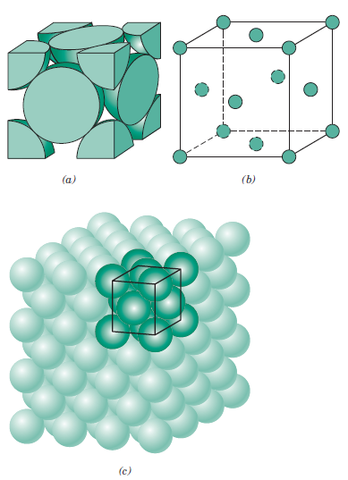
Crystalline materials: Unit Cell
When describing crystalline structures, atoms (or ions) are thought of as being solid spheres having well-defined diameters. This is termed the atomic hard-sphere model in which spheres representing nearest-neighbor atoms touch one another
Unit Cell: The basic structural unit of a crystal structure. Its geometry and atomic positions
define the crystal structure.
For the face centered cubic crystal structure (a) a hard sphere unit cell representation
(b) a reduced-sphere unit cell
(c) an aggregate of many atoms.

Slide 3
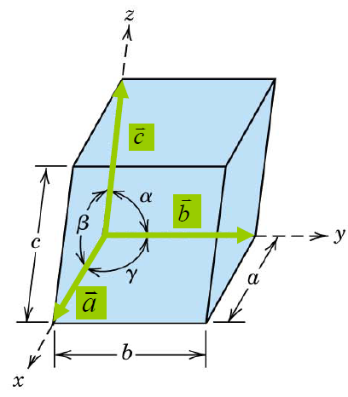

Unit cells and unit vectors
Lattice parameters=
axial lengths: a, b, c
interaxial angles: α, β, γ

Slide 4
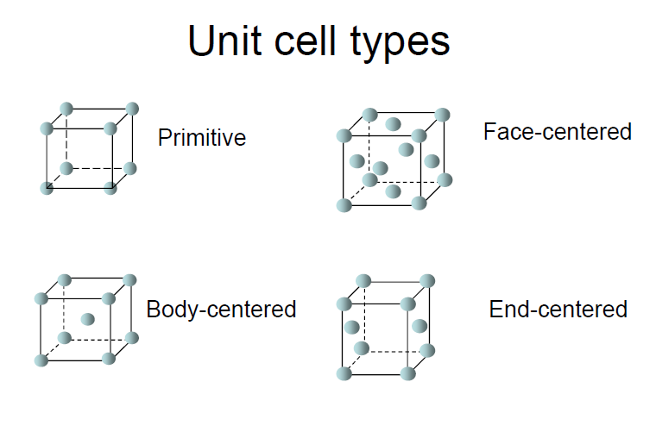

Slide 5
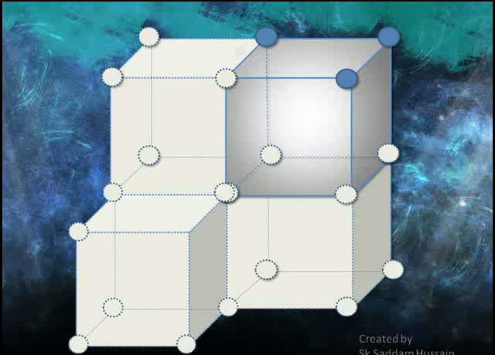
Two other important characteristics of a crystal structure:
Coordination number : the total number of nearest neighbor atoms
Atomic packing factor (APF): the fraction of volume in a crystal structure that is occupied by atoms.
For metals, each atom has the same number of nearest-neighbor or touching atoms, which is the coordination number
Simple Cubic Structure
• Coordination # = 6
(# nearest neighbors)

Slide 6

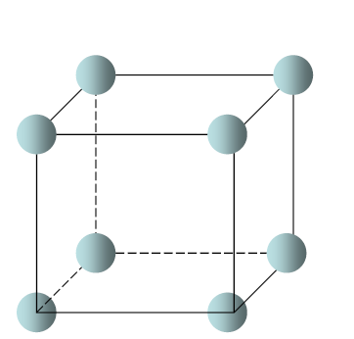
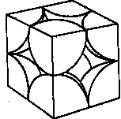
Atomic Packing Factor (APF)
Simple Cubic Structure
8 atoms but each atom is
shared by 8 unit cells.
→ 1 atom per unit cell
volume
atoms
atom
a
4
3
unit cell
1
π
(0.5a)
R=0.5a
3
APF =
a
3
volume
close-packed directions
unit cell
atomic radius=R
contains 8 x 1/8 =
unit cell length=a
1
atom/unit cell
• APF for a simple cubic structure = 0.52

Slide 7
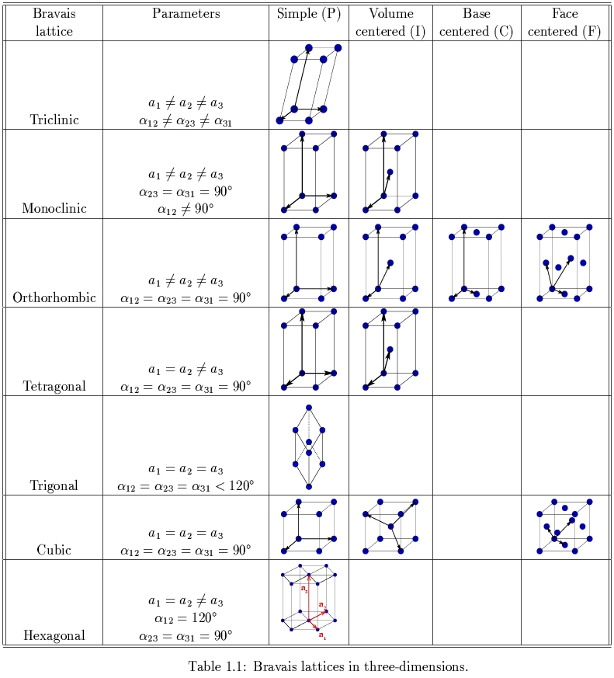
Bravais Lattices in 3-dimension

Slide 8
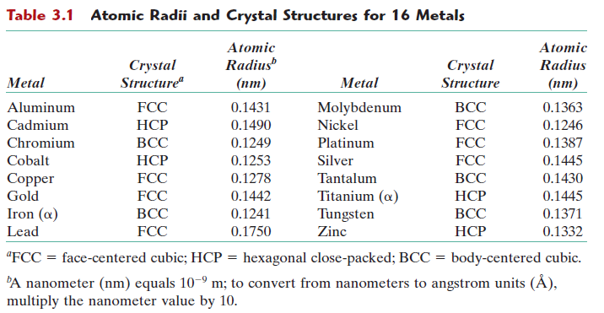
METALLIC CRYSTAL STRUCTURES
The atomic bonding in this group of materials is metallic and thus nondirectional in nature.
→the number and position of nearest-neighbor atoms => large numbers of nearest neighbors and dense atomic packings for metallic crystal structures.

Slide 9
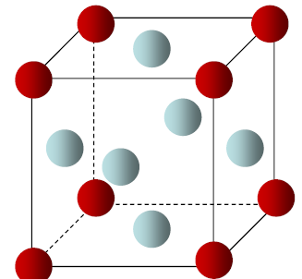
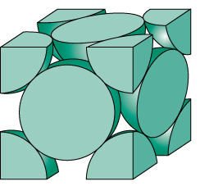

METALLIC CRYSTAL STRUCTURES
The Face-Centered Cubic Crystal (FCC) Structure
a hard-sphere model for the FCC unit cell
Each corner atom contributes as 1/8.
There are 8 corner atoms in an FCC unit cell.
ex: Al, Cu, Au, Pb, Ni, Pt, Ag
Each face atom contributes as 1/2.
There are 6 face atoms.

Slide 10
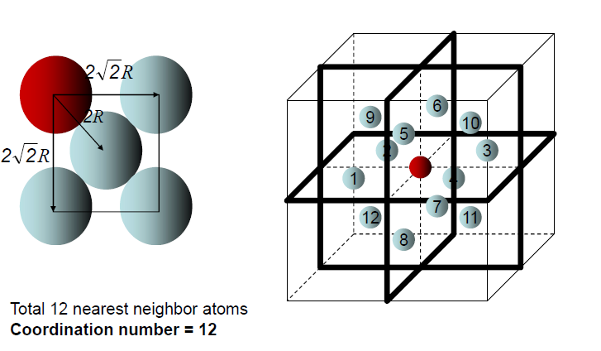
METALLIC CRYSTAL STRUCTURES
The Face-Centered Cubic Crystal (FCC) Structure
Coordination number for FCC

Slide 11
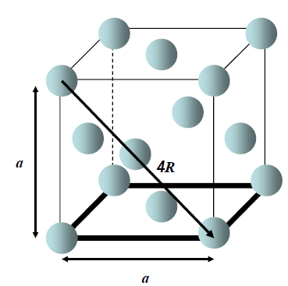
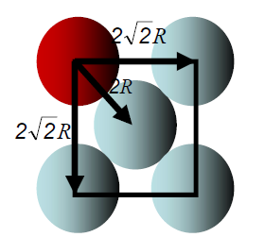



METALLIC CRYSTAL STRUCTURES
The Face-Centered Cubic Crystal (FCC) Structure
Atomic packing factor (APF) for FCC
a$\sqrt{2}$=4R => a =2$\sqrt{2}$R
atoms
volume
4
3
unit cell
4
π
(
2
a/4
)
3
atom
APF =
=0.74
3
volume
a
Independent of R and a!
unit cell

Slide 12
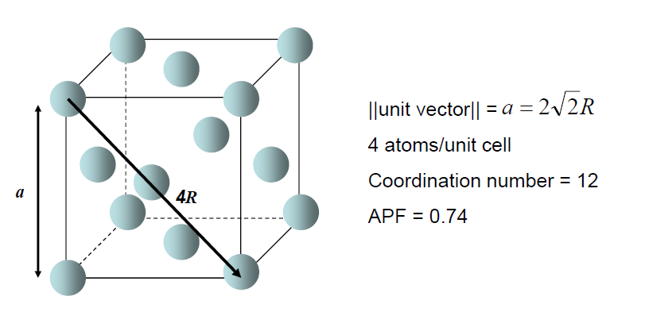
Summary for FCC
METALLIC CRYSTAL STRUCTURES

Slide 13
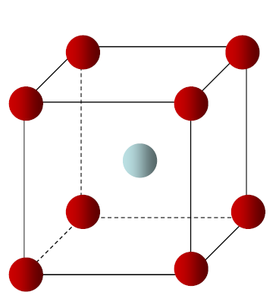
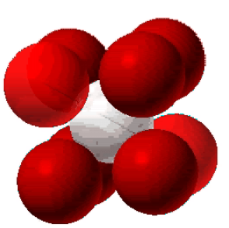
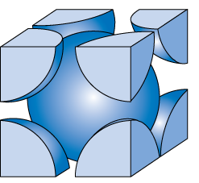

METALLIC CRYSTAL STRUCTURES
The Body-Centered Cubic (BCC) Crystal Structure
Each corner atom contributes as 1/8.
There are 8 corner atoms in
an FCC unit cell.
The center atom
contributes as 1.
There is only 1 center atom.
Ex: Cr, W, Fe (α), Ta, Mo,etc.

Slide 14
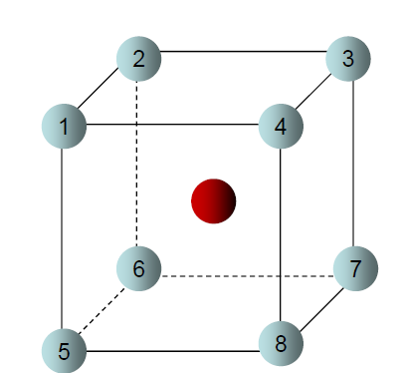
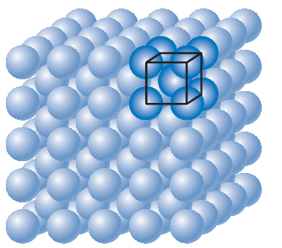
METALLIC CRYSTAL STRUCTURES
The Body-Centered Cubic (BCC) Crystal Structure
Coordination number for BCC
Total 8 nearest neighbor atoms
Coordination number = 8

Slide 15
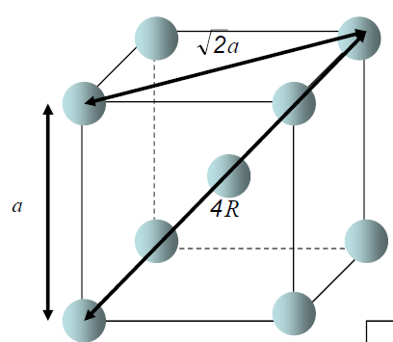
METALLIC CRYSTAL STRUCTURES
Atomic packing factor (APF) for BCC
Close-packed directions:
length = 4R =
3 a
atoms
volume
4
3
unit cell
2
π
(
3
a/4
)
3
atom
APF =
=0.68
3
volume
a
unit cell

Slide 16
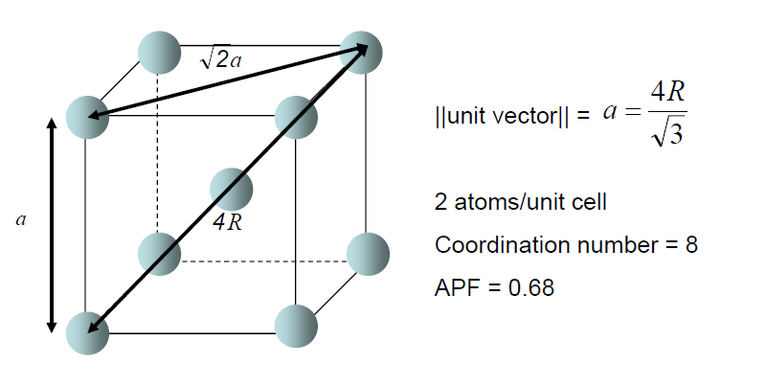
Summary for BCC
METALLIC CRYSTAL STRUCTURES

Slide 17
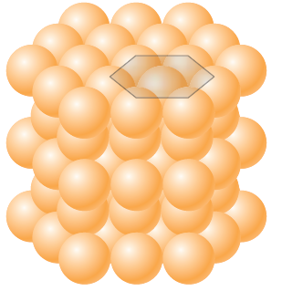
METALLIC CRYSTAL STRUCTURES
Hexagonal Close-Packing (HCP) Crystal Structure
• ABAB... Stacking Sequence
The top and bottom faces of the unit cell consist of six atoms that form regular hexagons and surround a single atom in the center.
• 3D Projection
A sites
• 2D Projection
c
B
sites
Top
layer
A sites
Middle layer
a
Bottom layer
• Coordination # = 12
• APF = 0.74
12×(1/6) + 2×(1/2) + 3 =
6 atoms/unit cell
• c/a = 1.633
• a = 2R
Ti, Mg, Zn, Co, Cd, Zr, Be
• V = a² × c × cos 30°
Notes:
The coordination number and the atomic packing factor for the HCP crystal structure
are the same as for FCC: 12 and 0.74, respectively

Slide 18

METALLIC CRYSTAL STRUCTURES
DENSITY COMPUTATIONS
A knowledge of the crystal structure of a metallic solid permits computation of its theoretical density through the relationship;
Mass
of
Atoms
in
Unit
Cell
Density = ρ =
Total
Volume
of
Unit
Cell
where n = number of atoms/unit cell
A = atomic weight
V_{C} = Volume of unit cell = a³ for cubic
N_{A} = Avogadro’s number
= 6.022 x 10²³ atoms/mol

Slide 19
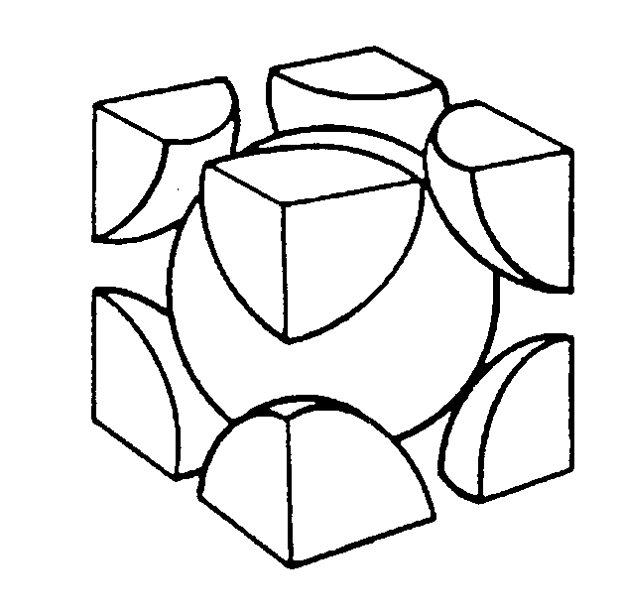
EXAMPLE PROBLEM: Theoretical Density, ρ
Cr (BCC) A = 52.00 g/mol R = 0.125 nm compute its theoretical density and compare the answer with its measure
n = 2 atoms/unit cell
R
a = 4R/ 3 = 0.2887 nm
Adapted from
Fig. 3.2(a), Callister & Rethwisch 8e.
a
ρ_{theoretical}
= 7.18 g/cm³
ρ_{actual}
= 7.19 g/cm³

Slide 20
Densities of Material Classes
In general
Metals/
Graphite/
Composites/
ρ
>
ρ
>
ρ
Ceramics/
Polymers
metals
ceramics
polymers
Alloys
Semicond
fibers
Why?
30
Platinum
B
ased on data in Table B1, Callister
2
0
*GFRE, CFRE, & AFRE are Glass,
Metals have...
• close-packing
(metallic bonding)
• often large atomic masses
Gold, W
Carbon, & Aramid Fiber-Reinforced
Tantalum
Epoxy composites (values based on
60% volume fraction of aligned fibers
10
Silver, Mo
in an epoxy matrix).
Cu,Ni
Steels
Tin, Zinc
Zirconia
Ceramics have...
• less dense packing
• often lighter elements
3
5
4
Titanium
Al oxide
(g/cm )
Diamond
3
Si nitride
Aluminum
Glass
-
soda
Glass fibers
Concrete
PTFE
ρ
2
Silicon
GFRE*
Polymers have...
• low packing density
(often amorphous)
• lighter elements (C,H,O)
Magnesium
Carbon
fibers
G
raphite
Silicone
CFRE
*
PVC
A
ramid fibers
PET
AFRE
*
1
PC
H
DPE, PS
PP, LDPE
0.5
Composites have...
• intermediate values
Wood
0.4
0.3
Data from Table B.1, Callister & Rethwisch, 8e.

Slide 21
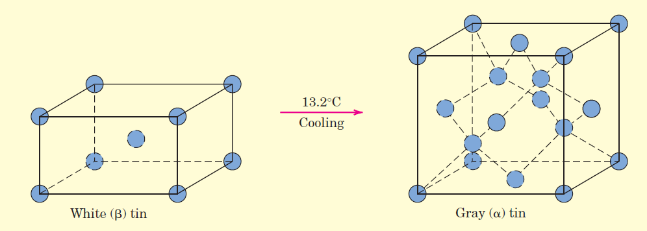
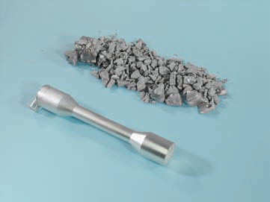
POLYMORPHISM AND ALLOTROPY
Some metals, as well as nonmetals, may have more than one crystal structure, a phenomenon known as polymorphism.
When found in elemental solids, the condition is often termed allotropy.
The prevailing crystal structure depends on both the temperature and the external pressure. Physical properties and density change during polymorphic transformations.
Example I: Carbon;
Graphite is the stable polymorph at ambient conditions
Diamond is formed at extremely high pressures
Example II: Iron;
BCC at room temperature
FCC at 912 °C
Example III: tin- “tin disease.”
Gray tin
Vol 27% ↑; density↓ (from 7.30 g/cm³ (white) to 5.77 g/cm³ (gray).
Body-centered tetragonal → cubic
White tin
The rate at which this change takes place is extremely slow!!! However could be faster at lower temperatures!!!

Slide 22
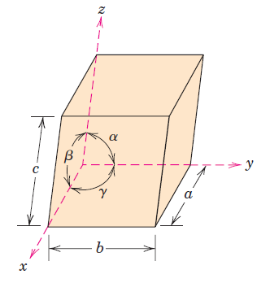
CRYSTAL SYSTEMS
The unit cell geometry is completely defined in terms of six parameters (lattice parameters of a crystal structure):
-the three edge lengths a, b, and c,
the three interaxial angles α, β , and γ.
On this basis there are seven different possible combinations of a, b, and c, and α, β,
and γ , each of which represents a distinct crystal system.
These seven crystal systems are cubic, tetragonal, hexagonal, orthorhombic, rhombohedral (trigonal), monoclinic, and triclinic.

Slide 23
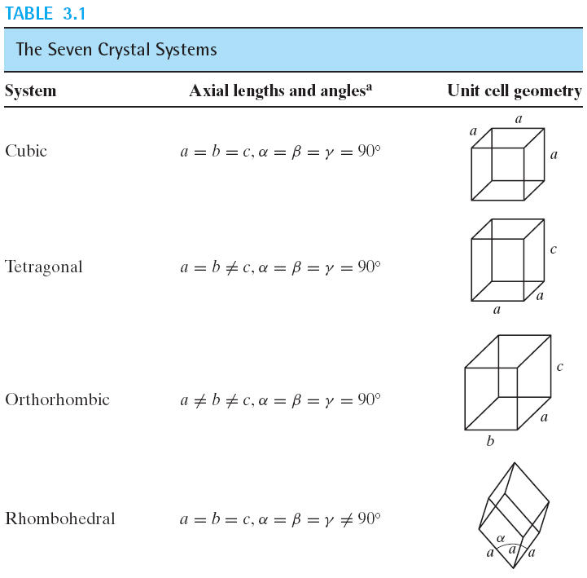
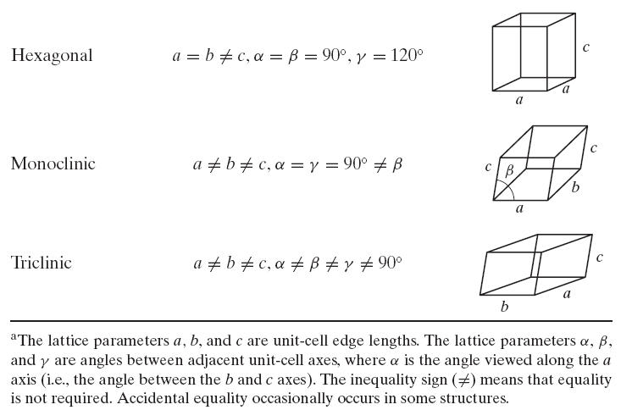
The cubic system, for which a =b =c and α= β= γ 90, has the greatest degree of symmetry.
The least symmetry is displayed by the triclinic system, because a≠b ≠ c and α ≠ β ≠ γ .

Slide 24
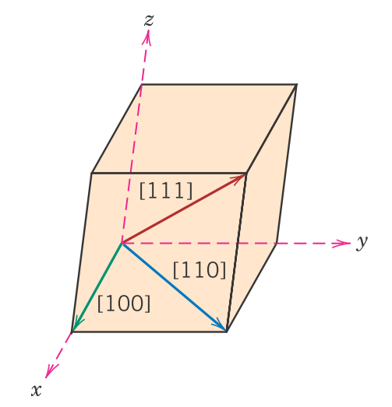
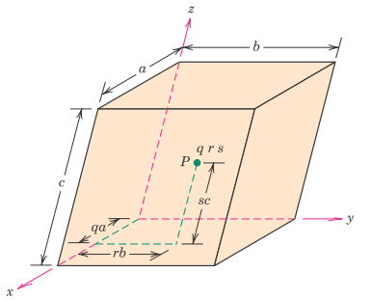
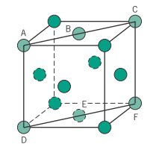
Crystallographic Points, Directions, and Planes
When dealing with crystalline materials, it often becomes necessary to specify a particular point within a unit cell, a crystallographic direction, or some crystallographic plane of atoms.

Slide 25
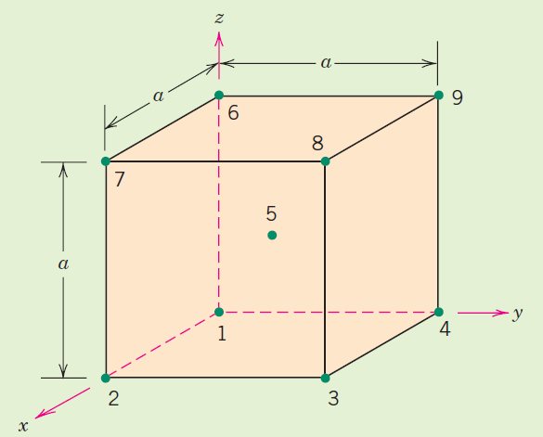
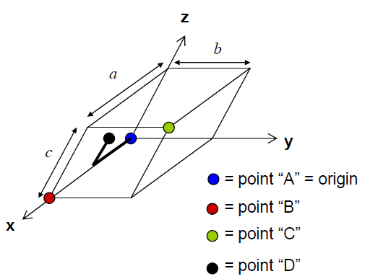
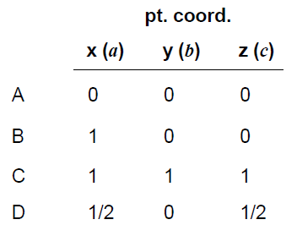
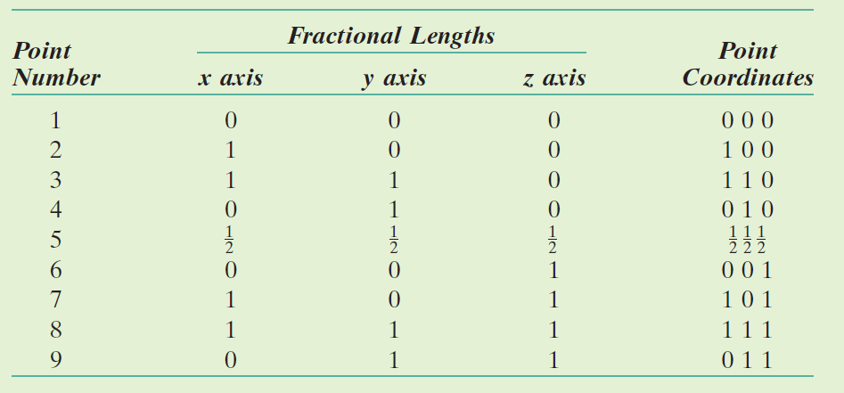
a) Point Coordinates
Crystallographic Points, Directions, and Planes
to define a point within a unit cell….
Essentially same as Cartesian coordinates except values of x, y, and z
are expressed as fractions of the magnitude of unit vector(s) (and x, y,
and z not necessarily orthogonal).
not to separate these coordinates by commas or any other punctuation marks!!!

Slide 26
b) Crystallographic Directions
Crystallographic Points, Directions, and Planes
z
A crystallographic direction is defined as a line between two points, or a vector.
Algorithm
1. Vector repositioned (if necessary) to pass
through origin. 2. Read off projections in terms of unit cell dimensions a, b, and c 3. Adjust to smallest integer values 4. Enclose in square brackets, no commas
[uvw]
y
x
ex: 1, 0, ½
=> 2, 0, 1
=> [ 201 ]
-1, 1, 1
=>
[ 111 ]
where overbar represents a negative index
if multiply by «–», [111] parallel but opposite direction
families of directions <uvw>

Slide 27

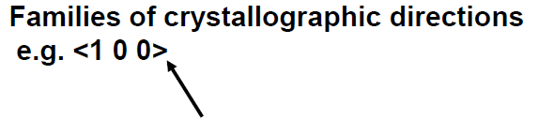
b) Crystallographic Directions; Con’d
Crystallographic Points, Directions, and Planes
Note: for some crystal structures, different directions can be equivalent.
e.g. For cubic crystals:
are all equivalent
Angled brackets denote a family of crystallographic directions.

Slide 28
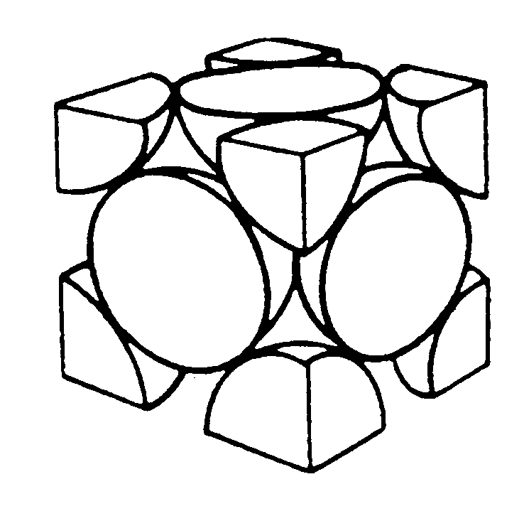
Linear Density
Linear density (LD) is defined as the number of atoms per unit length
Linear Density of Atoms ≡ LD =
Number of atoms
Unit length of direction vector
[110]
ex: linear density of Al in [110] direction a = 0.405 nm
if linear density of direction is same, the directions
are equivalent to each other.
# atoms
a
2
Adapted from
Fig. 3.1(a),
Callister & Rethwisch 8e.
LD
=
=
3.5 nm
−
1
2
a
length
the units of linear density are reciprocal length (e.g., nm⁻¹, m⁻¹).

Slide 29
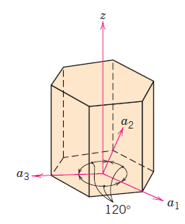
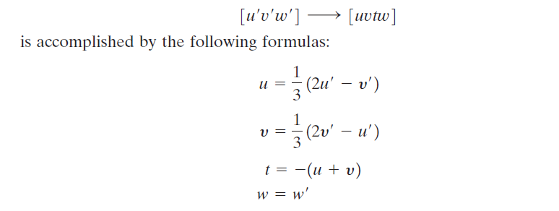
b) Crystallographic Directions; Con’d
Crystallographic Points, Directions, and Planes
Hexagonal Crystals
Directional indices, which are obtained as described earlier, will be denoted by four indices, as [uvtw]; by convention, the first three indices pertain to projections along the respective a1, a2, and a3 axes in the basal plane.
-
-
[010] → [1210]
Coordinate axis system for a hexagonal unit cell
(Miller–Bravais scheme)

Slide 30
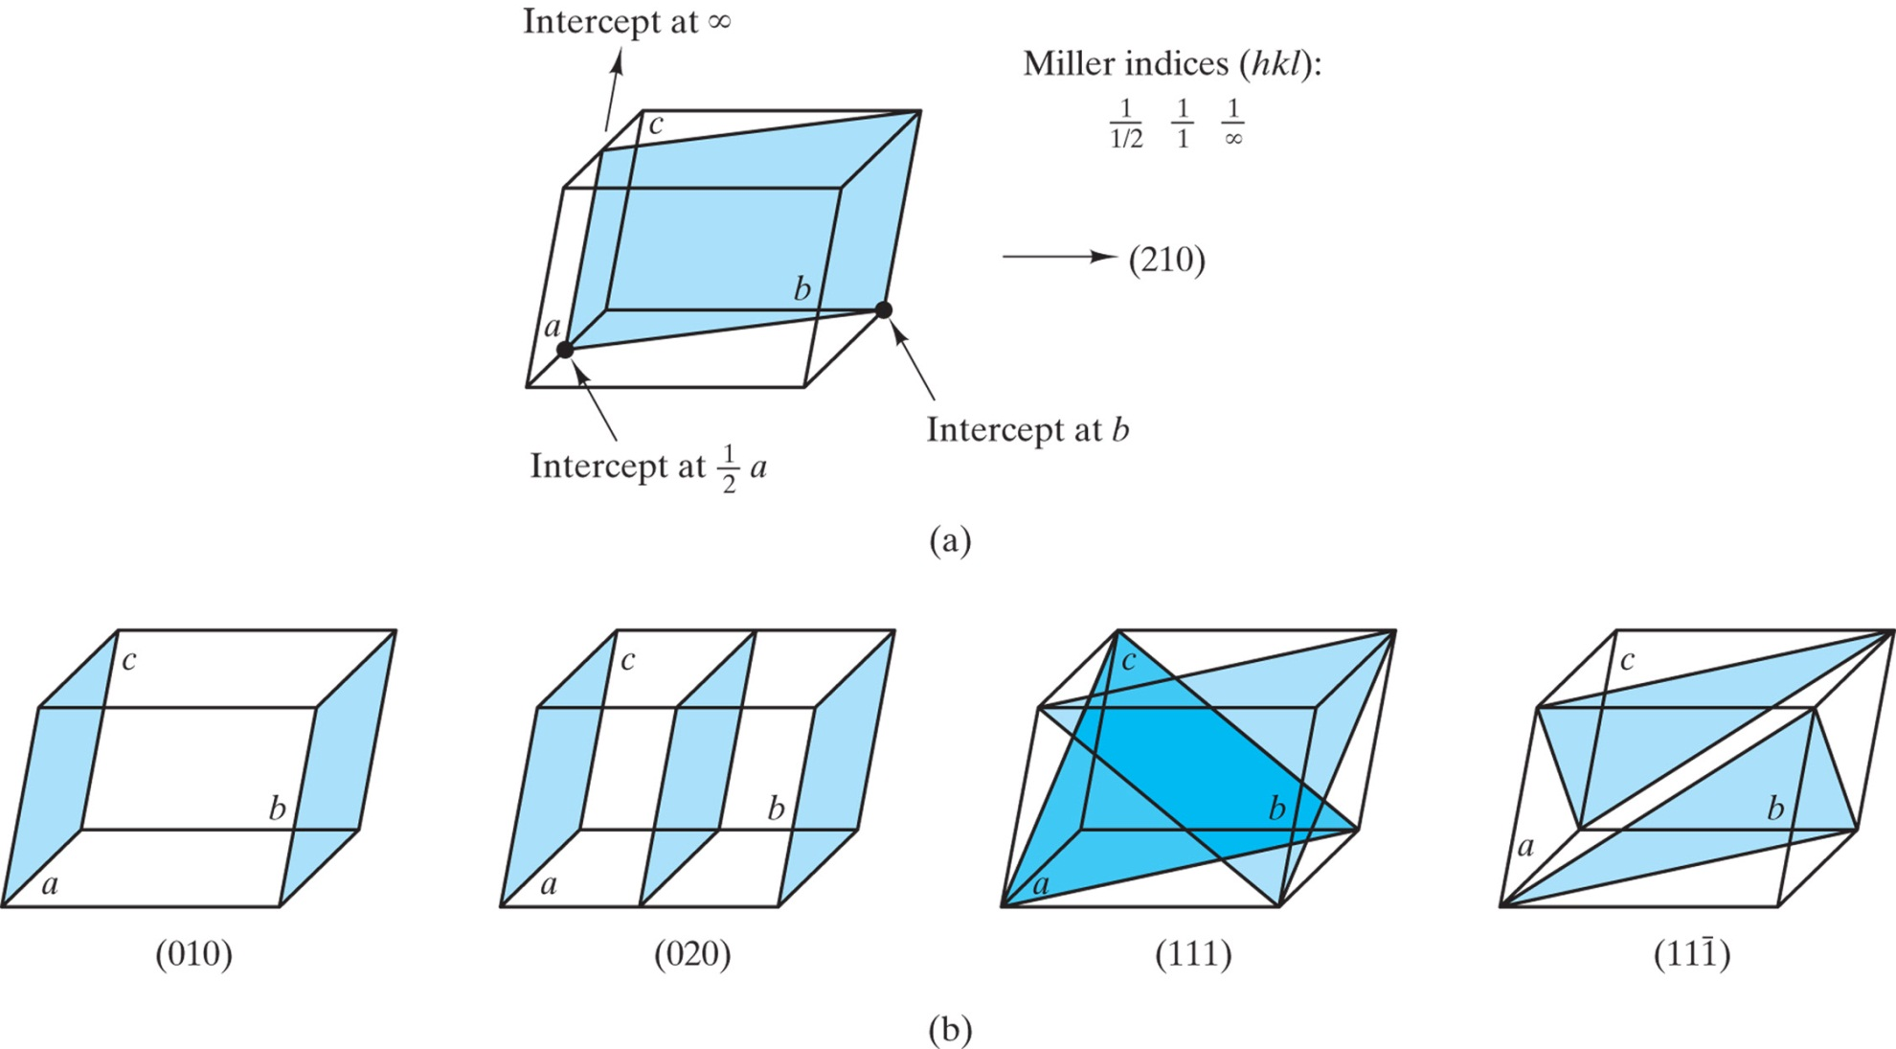
c) Crystallographic Planes
Crystallographic Points, Directions, and Planes
Algorithm
1. Read off intercepts of plane with axes in
terms of a, b, c
2. Take reciprocals of intercepts
3. Reduce to smallest integer values
4. Enclose in parentheses, no
commas i.e., (hkl)

Slide 31
c) Crystallographic Planes
Crystallographic Points, Directions, and Planes
z
example
a b c
c
1. Intercepts
1 1 ∞
2. Reciprocals
1/1 1/1 1/∞
1 1 0
3. Reduction
1 1 0
y
a
b
4. Miller Indices (110)
x

Slide 32
Crystallographic Points, Directions, and Planes
c) Crystallographic Planes
z
example
a b c
c
1. Intercepts
1/2 1 3/4
2. Reciprocals
1/½ 1/1 1/¾
2 1 4/3
y
3. Reduction
6 3 4
a
b
4. Miller Indices (634)
x

Slide 33
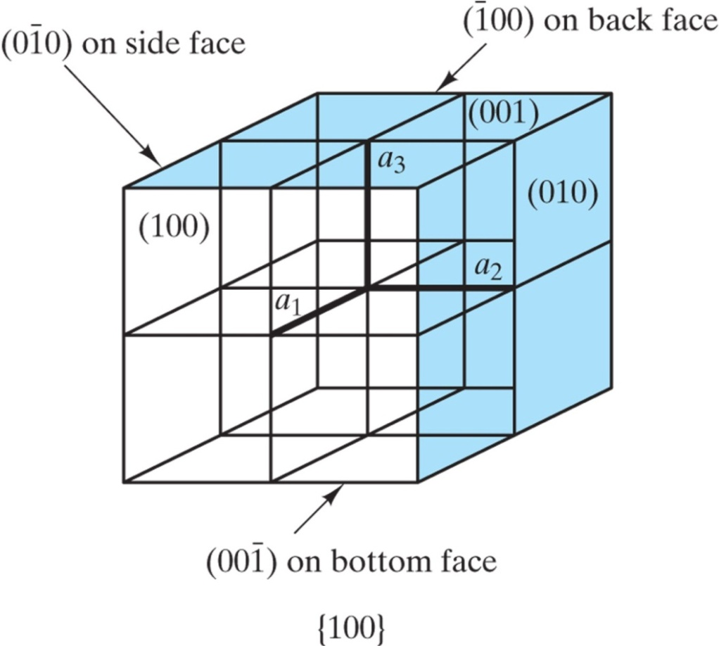
Crystallographic Points, Directions, and Planes
c) Crystallographic Planes
Family of planes
A “family” of planes contains all those planes that are crystallographically equivalent—that is, having the same atomic packing; and a family is designated by indices that are enclosed in braces—such as {100}
Family of planes, {100}, representing all faces of unit cells in the cubic system.

Slide 34

PLANAR DENSITIES
Planar density (PD) is taken as the number of atoms per unit area that are centered on a particular crystallographic plane
The units for planar density are reciprocal area (e.g., nm⁻², m⁻²).
Example:
Draw (100) crystallographic planes
for Fe.
Calculate the planar density for each of these planes.

Slide 35
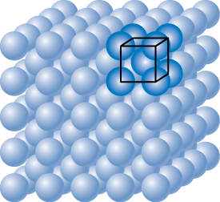
Planar Density of (100) Iron
Solution: At T < 912⁰C iron has the BCC structure.
2D repeat unit
(100)
4
3
a
=
R
3
Adapted from Fig. 3.2(c), Callister & Rethwisch 8e.
Radius of iron R = 0.1241 nm
atoms
2D repeat unit
1
1
atoms
atoms
Planar Density =
=
2
=
12.1
= 1.2 x 10¹⁹
a
2
4
3
nm²
m²
area
R
2D repeat unit
3

Slide 36
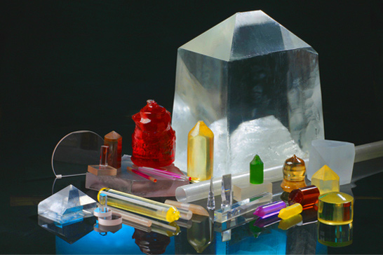
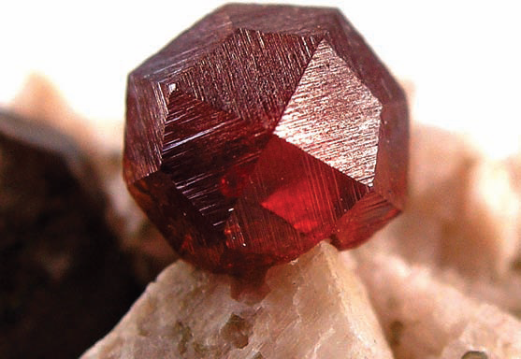
Crystalline and Noncrystalline Materials
SINGLE CRYSTALS:
For a crystalline solid, when the periodic and repeated arrangement of atoms is perfect or extends throughout the entirety of the specimen without interruption, the result is a single crystal.
All unit cells interlock in the same way and have the same orientation
produced artificially
Naturally exist
Within the past few years, single crystals have become extremely important in many of our modern technologies, in particular electronic microcircuits, which employ single crystals of silicon and other semiconductors.
http://iscrystals.com/contentimages/site/crystals.jpg
Photograph of a garnet single crystal that was found in Tongbei, Fujian Province, China.

Slide 37
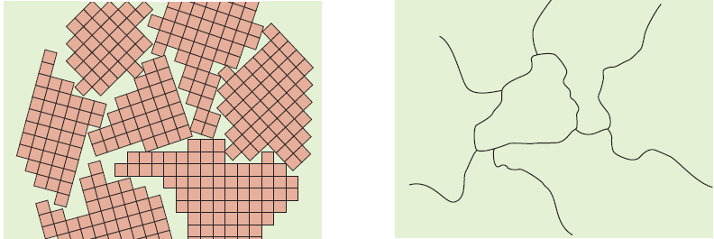
Crystalline and Noncrystalline Materials
2. POLYCRYSTALLINE MATERIALS:
Most crystalline solids are composed of a collection of many small crystals or grains; such materials are termed polycrystalline
small crystals or grains

Slide 38
Noncrystalline Materials
Crystalline materials...
• atoms pack in periodic, 3D arrays
• typical of:
-metals
-many ceramics
-some polymers
crystalline SiO2
Adapted from Fig. 3.23(a),
Callister & Rethwisch 8e.
Si
Oxygen
Noncrystalline materials...
• atoms have no periodic packing
• occurs for:
-complex structures
-rapid cooling
"Amorphous" = Noncrystalline
noncrystalline SiO2
Adapted from Fig. 3.23(b),
Callister & Rethwisch 8e.

Slide 39
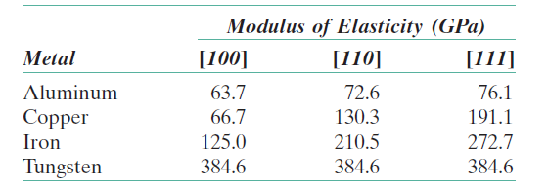
Crystalline and Noncrystalline Materials
3. ANISOTROPY :
If the physical properties (the elastic modulus, the electrical conductivity, and the index of refraction, etc.) of single crystals of some substances depend on the crystallographic direction in which measurements are taken, this directionality of properties is termed as an anisotropy, associated with the variance of atomic or ionic spacing with crystallographic direction.
The extent and magnitude of anisotropic effects in crystalline materials are functions of the symmetry of the crystal structure;
e.i. the degree of anisotropy ↑ with ↓ structural symmetry—triclinic structures normally are highly anisotropic.
Substances in which measured properties are independent of the direction of measurement are isotropic.

Slide 40
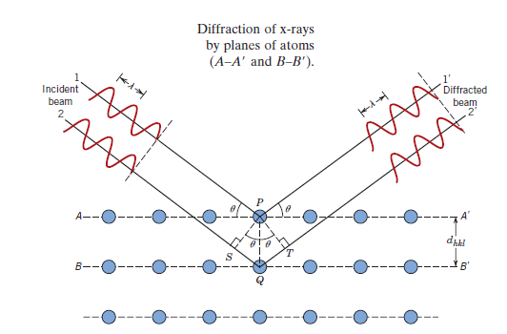
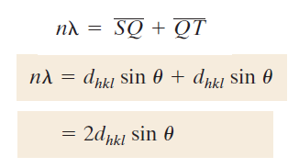
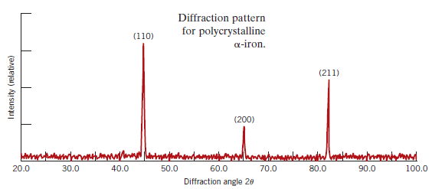

X-ray diffraction and Bragg’s Law
X-rays are a form of electromagnetic radiation with short wave-lengths and high energies.
n: order of reflection,
may be integer (1, 2, 3, etc..
For cubic symmetry:

Slide 41



Example: For BCC iron, compute (a) the interplanar spacing, (b) the diffraction angle for the (220) set of planes. The lattice parameter for Fe is 0.2866 nm. Monochromatic radiation having a wavelength of 0.1790 nm is used, and the order of reflection is 1.
(a)
(b)

